Slide 1
Experiential Learning Phase -I :
SMART PLANT MONITORING SYSTEM USING IoT AND OTHER SENSORS
BY:
KUSHAL R U– 1RV22CS093
MANOJ KUMAR B V– 1RV23CS407
MOHAMMED ADNAN – 1RV23CS409
NAGAPRASAD NAIK– 1RV23CS410

Slide 2
PRESENTATION CONTENTS
1.Problem Statement
2. Relevance of the topic
3. Methodology
4. Outcomes

Slide 3
Problem Statement
Problem Statement: Smart Plant Monitoring System Using IoT and Other Sensors
In modern agriculture, maintaining optimal plant health and maximizing crop yields is a significant challenge. Traditional farming methods often rely on manual monitoring and generalized care, which can lead to inefficiencies and potential losses due to undetected issues such as pests, diseases, or suboptimal growing conditions. The lack of real-time data on critical environmental parameters and plant health indicators results in delayed responses to problems, affecting crop quality and yield.

Slide 4
Problem Statement
Relevance of the Topic: Smart Plant Monitoring System Using IoT and Other Sensors
Why It Is Required: Problems It Solves:
Increased Efficiency and Productivity Manual Monitoring Inefficiencies
Sustainable Agriculture Delayed Problem Detection
Real-Time Monitoring and Response Climate Variability
Labor Optimization Economic Viability
Data-Driven Decision Making Prevents Resource Waste

Slide 5
LITERATURE SURVEY
Sl No. | Papers | Authors | Summary
1 | Smart Plant Monitoring System | Sreeram Sadasivam Vishwanath Vadhri Supradha Ramesh | This paper reviews plant monitoring technologies, including wireless sensor networks (WSNs) and IoT for real-time data collection and remote control. It discusses data analysis methods and practical implementations, highlighting advancements, challenges, and future directions in the field..

Slide 6
LITERATURE SURVEY
2 | Design of an IoT based Smart Plant Monitoring System | Apeksha Rane, Bhushan Vidhale, Priyankka Hemanth Kale | This paper reviews previous research on agriculture automation and plant monitoring. It covers various technologies, including wireless sensor networks (WSNs) and IoT for monitoring greenhouse conditions, soil moisture, and environmental parameters. The survey highlights different sensors and controllers used in these systems to reduce manpower and improve efficiency in agriculture. It emphasizes the integration of microcontrollers and wireless communication for real-time data collection and control.

Slide 7
LITERATURE SURVEY
3 | A Sensor based IoT Monitoring System for Electrical Devices using Blynk framework | Dr. P. Karrupusamy, | The literature survey in "A Sensor Based IoT Monitoring System for Electrical Devices using Blynk Framework" discusses previous work on home automation, energy management, and plant monitoring systems using IoT. It highlights the use of Blynk for real-time control and data storage, blockchain for data security, and various sensors and microcontrollers for monitoring and controlling electrical devices. The survey underscores advancements in IoT for remote monitoring, energy efficiency, and data protection.

Slide 8
LITERATURE SURVEY
4 | Affordable field environmental monitoring and plant growth measurement system for smart agriculture | Takashi Okayasu; Andri Prima Nugroho; Atsushige Sakai; Disaku Arita; Takashi Yoshinaga | The study discusses the integration of affordable sensors and devices in the agriculture sector. These technologies have been employed to enhance farming knowledge and techniques, reduce production costs, and improve the quality of agricultural products. The paper provides an overview of the current state and examples of affordable sensors and devices used for monitoring field environments and measuring plant growth in smart agriculture.

Slide 9
LITERATURE SURVEY
5. | IoT Based Smart Plant Monitoring System | Vibha Nehra, Megha Sharma, Vaibhav Sharma | This paper discusses an Internet of Things (IoT) based system designed for monitoring plant health and automating irrigation. The system utilizes various sensors to measure soil moisture, temperature, and humidity, enabling efficient water usage and better plant growth.

Slide 10
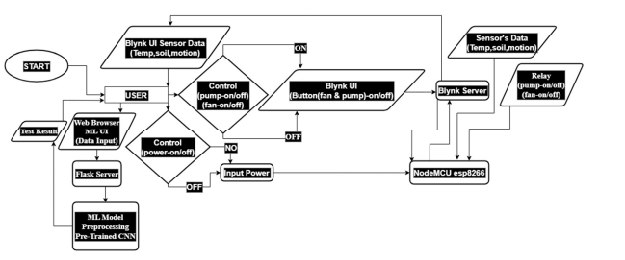
METHODOLOGY
Fig: System Design

Slide 11
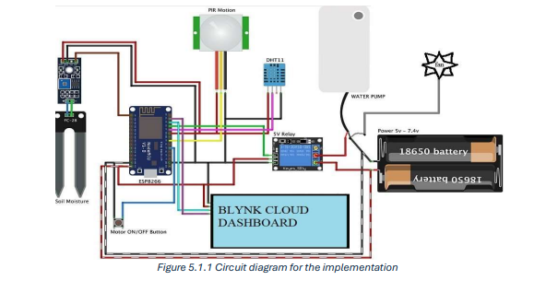
METHODOLOGY
Fig : Circuit Design

Slide 12
METHODOLOGY
System design figure shows the functionalities of our project. Building upon the frameworks discussed in the previous section Blynk, Flask, pre-trained CNN model, the system design lays out the architecture for data acquisition, processing, control, and user interaction.
The central component of the circuit is the ESP8266 (NodeMCU), which manages all the sensors and controls the actuators. It connects to the Blynk Cloud Dashboard, allowing for remote monitoring and control of the greenhouse environment. The ESP8266 receives input from several sensors and sends commands to the relay module, which in turn controls high-power devices.The Soil Moisture Sensor measures the moisture level in the soil and is connected to the analog input pin of the ESP8266. This sensor provides real-time data on soil moisture, which is crucial for determining when to activate the water pump. Additionally, a PIR Motion Sensor is connected to a digital input pin on the ESP8266. This sensor detects motion within the greenhouse, providing alerts for any detected movement, which could be useful for security or monitoring purposes

Slide 13
OBJECTIVES
Increase efficiency and productivity by monitoring and controlling through IOT sensors and devices
Resource conservation is another significant benefit
To improve crop yield and quality
Resource conservation
Cost-efficient and less time-consuming
To enhance crop yield and quality
Early detection of plant diseases
IoT-based monitoring and control systems

